Slide 1

BRAIN DRAIN
Valerio Di Palo, Susan Hu, Aliya Davletshina, Kasra Zamanian

Slide 2
ROADMAP
INTRODUCTION
What is brain drain?
WHY BRAIN DRAIN?
Literature Review
THE DATA
EDA
Network Visualization
THE MODEL
Decision Making Process
ABM
IMPLEMENTATION
Model Development
Notes:
What is brain drain (def)
Literature review → Why. Research questions
Exploratory Data Analysis
data we have
Networks (over the years?)
Methodology: ABM
Assumptions
Simulation and calibration
Change of public policies
Results that we want to achieve
Limitations
Conclusion, implication, improvements
Thank you! Question?

Slide 3
WHAT IS
BRAIN DRAIN?
01

Slide 4


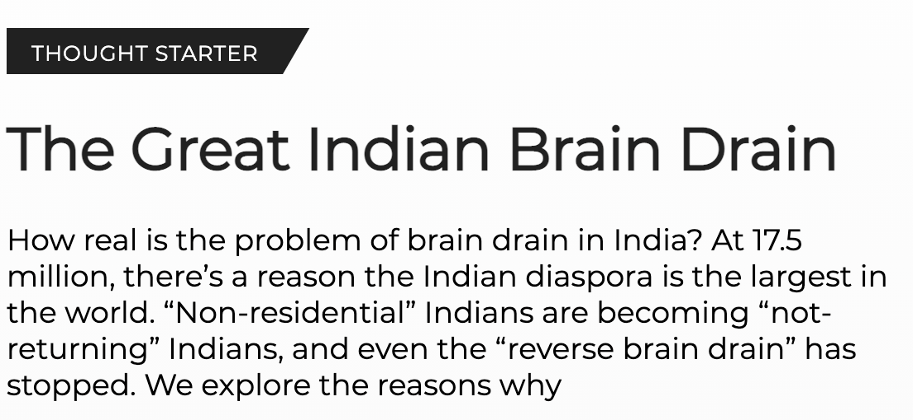

THE PHENOMENON OF BRAIN DRAIN
Brain drain is the “international migration of highly qualified persons, e.g. surgeons, physicians, scientists and engineers, from low income countries to more prosperous economies” (Donald Rutherford, 1992)
Notes:
The brain drain phenomena is a specific implication of the more geneal migration phenomena. By itself migration represents for individuals a great opportunity to grow and explore but, its effect become much more complicated when it involves big proportion of the most valuable talents of a country. In italy it is a well known phenomena that affects the most talented students but its effect are particularly relevant also in other countries as India.According to Alejandro Portes in his paper: the determinants of brian drain, the most talented students after years of studies and sacrifies are particularly prone to leave their home country, searching for better opportunities and this phenomena is a result of international and internal structural imbalances.

Slide 5

THE EFFECTS OF BRAIN DRAIN
DEPARTURE
COUNTRIES
DESTINATION
COUNTRIES
Reduced ability to progress
Direct economic loss
Competition growth in the job market
Brain waste
Economic Impact of Brain Drain in Developed and Developing Countries - Dr. Babita Srivastava Eight Questions about Brain Drain - John Gibson
Notes:
NEGATIVE EFFECT FOR SENDING First and foremost, brain drain causes developing countries to lose the ability to progress. Without growth and improvements that could have been provided by the skillful people, the country can no longer attempt to compete globally. and is left behind with respect to the rest of the world. This aspect can undermine development and progress even further and cause a slowdown in the nation’s growth.Furthermore, from an economic standpoint, Talented people are born, raised, and educated in their country, which represents an invesment for the home government, and when it comes their time to work and be taxpayer , they leave and seek employment elsewhere., causing a direct economic loss.RECEIVINGAbout the receving countries, these are usually the most developed ones, these can offer to the immigrants better opportunites and personal growth. As a consequence it can cause a competition growth in the host country and it can result in brain waste. So, there are too many workers for a limited amount of jobs, which leads them to accept job position for which are too much qualified or either unemployment .THE DOMINO EFFECT Basically, brain drain has the potential to cause a dangerous “domino” effect. If this trend is unregulated it can have terrible effects.Logically speaking, overloading developed nations with highly educated people while simultaneously draining them from undredeveloped ones is highly detrimental to both.

Slide 6
02
WHY BRAIN DRAIN?

Slide 7
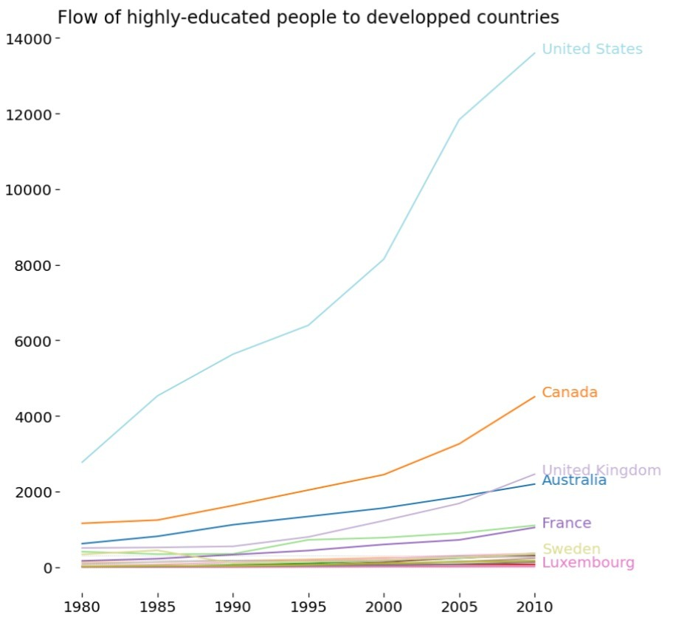
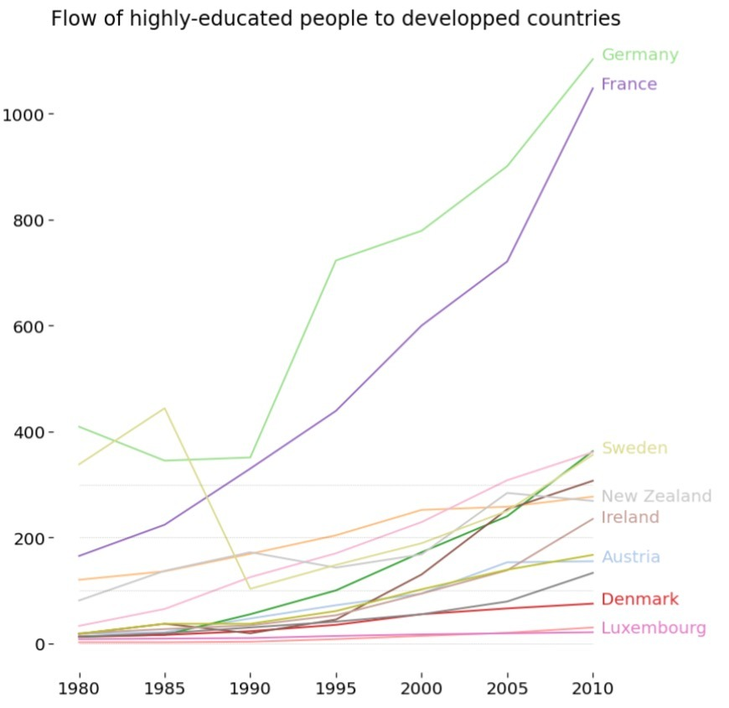
WHY BRAIN DRAIN IS IMPORTANT?
Where do world’s talents immigrate to?
Raising phenomenon
Policy concerns*
Social threat to underdeveloped countries
*Addressing brain drain: The local and regional dimension – European Commission for Social Policy, Education, Employment, Research and Culture
Notes:
We choose to investigate the brain drain phenomena because of many reson but mainly because -it is raising in its importance, infact there is a growth in the number of studies in this area over the last years-because it represents a social threat to both underdeveloped and developed countries -and because it is causing policy concerns in the international political landascape.

Slide 8


LITERATURE REVIEW
BRAIN DRAIN
MIGRATION & ABM
• Determinants of the Brain Drain (Alejandro Portes)
• The Brain Drain. A Survey of the Literature (Pierpaolo Giannoccolo)
• Brain Drain, Brain Gain and Brain Return Explained by a Model based on a Comparable Individual Country’s well-being Indicator (LISE) (Liminta Luca Giovangiuseppe)
• An Agent-Based Modeling Approach to Brain Drain (Furkan Gürsoy and Bertan Badur)
• Agent-based modeling for migration and modern slavery research: a systematic review ( McAlpine et al., 2020)
• Migration and social networks—An explanatory multi-evolutionary agent-based model (Barboca et al., 2011)
Notes:
About the literature review, The papers that we usde to define our idea, CAN BE DIVIDED IN TWO CATEGORIES:In the Brain drain category we find the “empirical paper” , the ones that talk about the brain drain phenomena as a result of international imbalances between countries and analyze it mainly in a macroeconomic perspective. Meanwhile in the second category we find papers that define abm models taking into account individual drivers and others more focused on the migration in general Our is idea is to create a point of conjunction between these two kind of papers. So we aim to develop a model that takes both into account personal factor and macroeconomic factors, as we will se better in the model specification presented by Kasra, to find an answer to our research question. I’ll leave the stage to susan that will present the Exploratory data analysis.

Slide 9
RESEARCH QUESTIONS
Can we model Brain-drain considering a combination of country-specific macroeconomic indicators & agent-specific behavioral factors?
Model the decision-making process for the destination
Distribution of the inflow and outflow
Study the agents’ reactions towards different policies
Notes:
Can we model brain drain with micro macro features
Study behavior of BD
general behavior
policies changing
new distribution of outflow inflow
does our ABM reflect the real data?
What are the effects of BD if we change countries’ policies and to mitigate the phenomenon
Calibrate countries’ policies to understand
Time

Slide 10
DATA
03

Slide 11
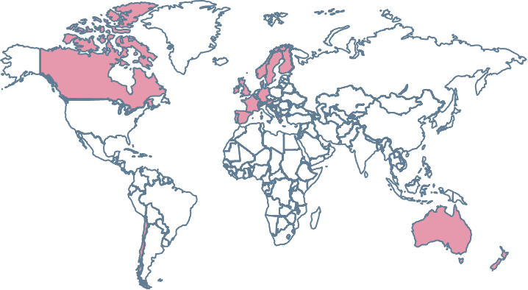
THE DATA
Austria
Switzerland
Germany
Denmark
Spain
Finland
France
UK
Greece
Ireland
Luxembourg
Netherlands
Norway
Portugal
Sweden
Canada
USA
Inflow of people from all over the world into each of the 20 destination countries
Time period: 1980-2010
5-year increment
Chile
People divided by 3 education levels (Low, Medium, High)
Australia
New Zealand

Slide 12
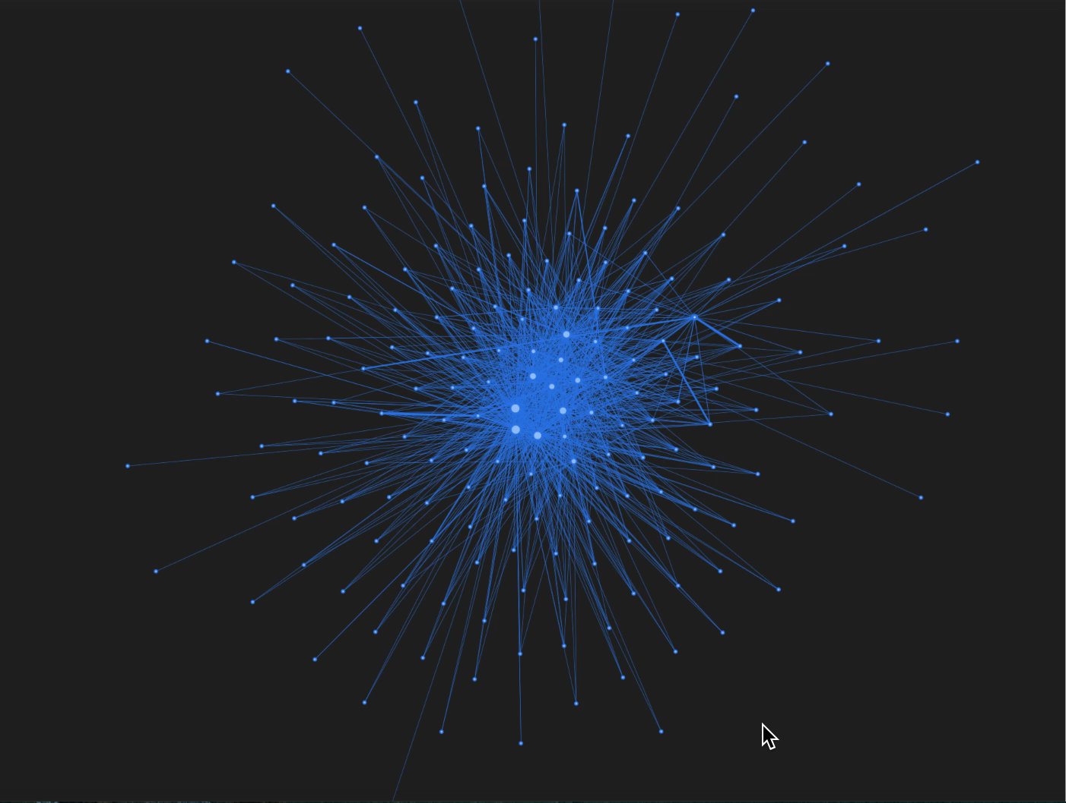
Flow of high skilled people network

Slide 13
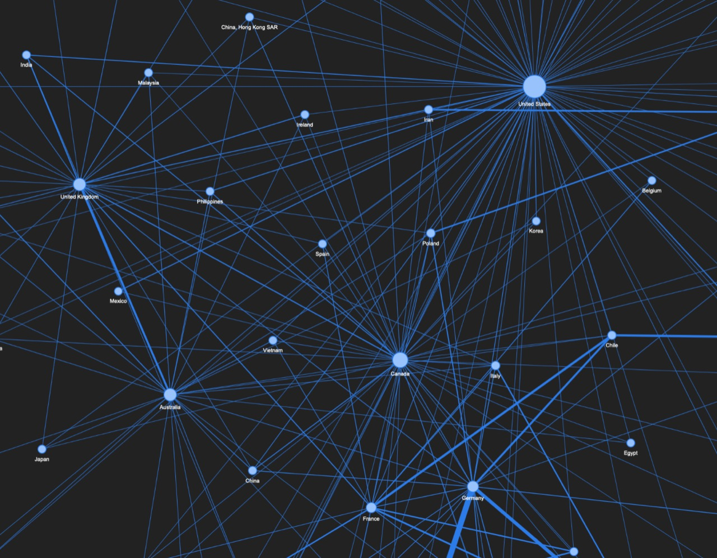

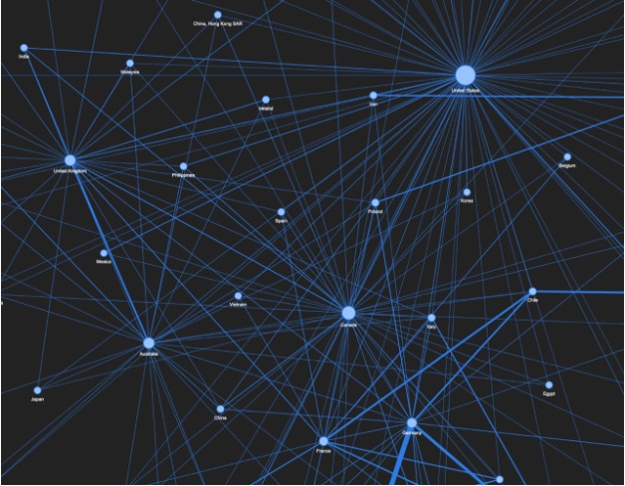

Slide 14
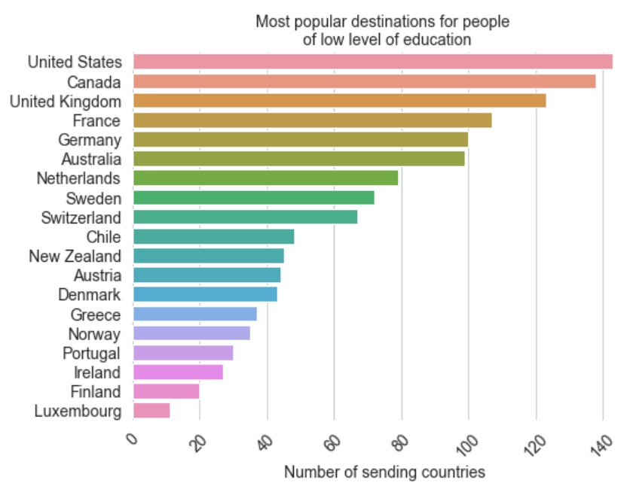
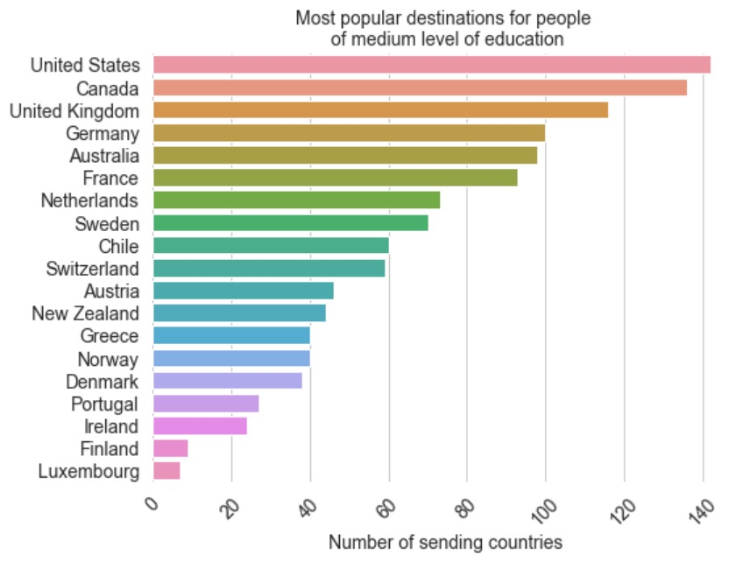
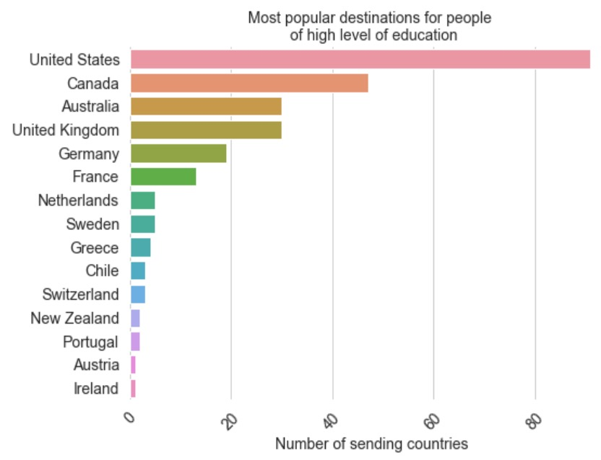
EXPLORATORY DATA ANALYSIS
LOW LEVEL
MEDIUM LEVEL
HIGH LEVEL

Slide 15
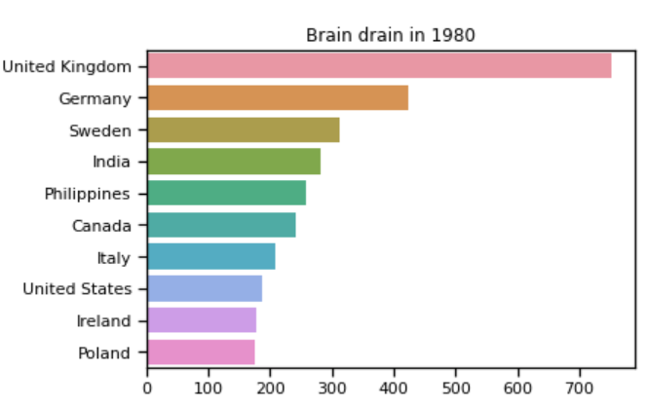
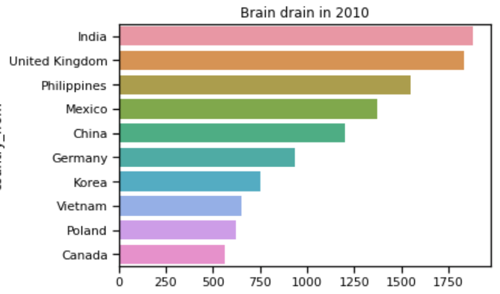
EXPLORATORY DATA ANALYSIS

Slide 16
THE MODEL
04

Slide 17
THE DECISION MAKING PROCCESS
Do I want to migrate?
Which country
can maximize
my level of
HAPPINESS?
Where do I want to migrate?
Internal/ personal factors
External/ macro factors
Age
Gender
Ambition
Peer-effects
Income
GDP
Gov. exp. Education
Gov. exp. Health
Life expectancy
HDI

Slide 18
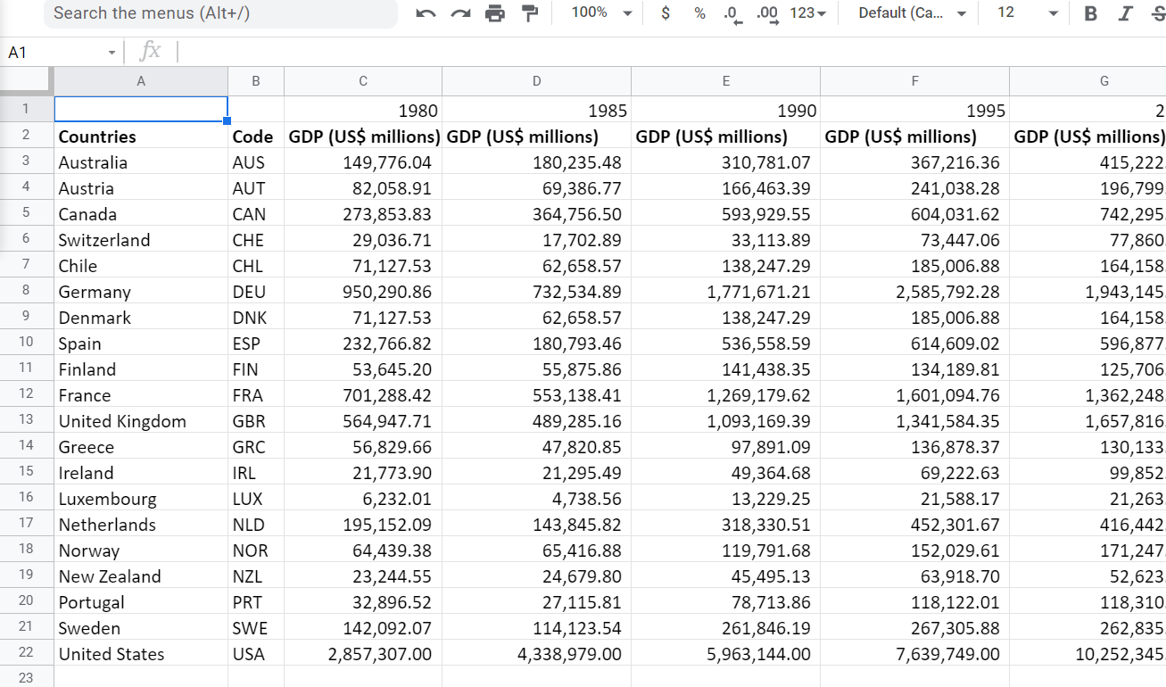
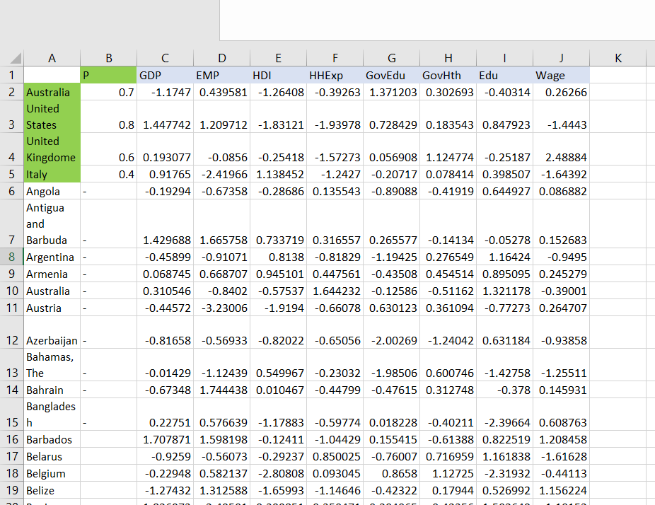
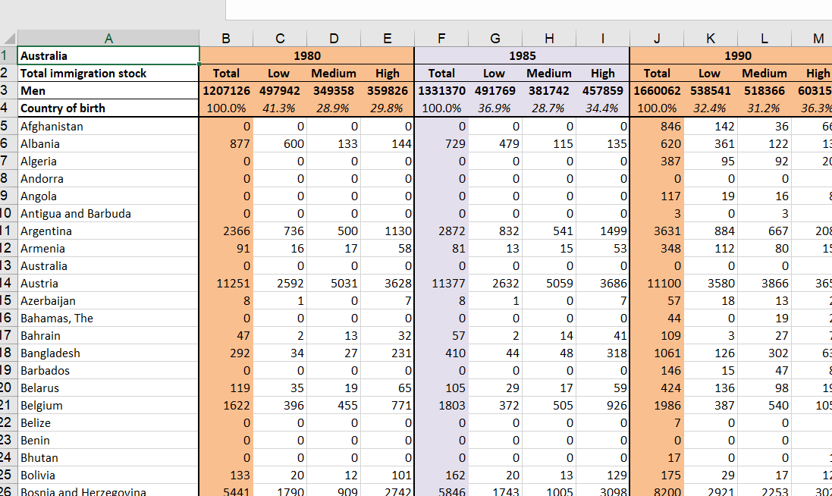

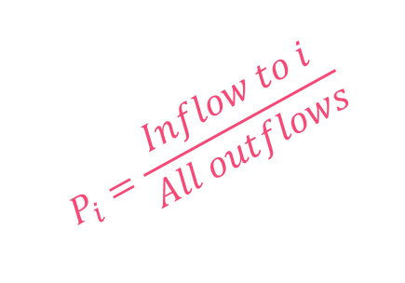
COEFFICIENTS
NORMALIZE
$$W_{GDP}$$
$$W_{\begin{aligned}EMP \\ \end{aligned}}$$
$$W_{\begin{aligned}HDI \\ \end{aligned}}$$
$$W_{\begin{aligned}HHExp \\ \end{aligned}}$$
…
$$P_{i}=\frac{Inflow to i}{All outflows}$$

Slide 19







AN EXAMPLE
GDP | -1.17
EMP | 0.44
HDI | -1.26
HHExp | -0.39
GovEdu | 1.37
GovHth | 0.30
Edu | -0.40
Wage | 0.26
-0.46
-0.91
0.81
-0.82
-1.19
0.28
1.16
-0.95
1.45
1.21
-1.83
-1.94
0.73
0.18
0.85
-1.44
0.19
-0.09
-0.25
-1.57
0.06
1.12
-0.25
2.49
Starting from ITALY
$P_{It−US}=\frac{ⅇ^{W_{GDP}.\left({GDP}_{It}−{GDP}_{US}\right)+W_{EMP}.\left({EMP}_{It}−{EMP}_{US}\right)+…}}{ⅇ^{W_{GDP}.\left({GDP}_{It}−{GDP}_{US}\right)+W_{EMP}.\left({EMP}_{It}−{EMP}_{US}\right)+…} +1}$ = 0.6
$$P_{Stay−US}=1 −0.6=0.4$$

Slide 20





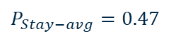

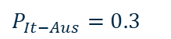



AN EXAMPLE
Probability of each country
Probability of staying
Rescaled probabilities
$P_{It−US}=$ $0.6$
$P_{It−US}$ = 0.29
$$P_{Stay−US}=0.4$$
$P_{It−Ger}=0.7$
$$P_{Stay−Ger}=0.3$$
$P_{It−Ger}$ = 0.34
$$P_{It−Aus}=0.3$$
$$P_{Stay−Aus}=0.7$$
$P_{It−Aus}$ = 0.14
$$P_{Stay−avg}\text{=} 0.23$$
$$P_{Stay−avg}=0.47$$

Slide 21
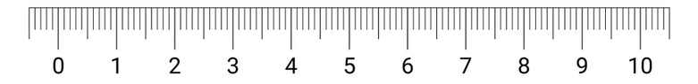
Germany
Australia
Staying
USA
2.9
R = rand()
3.4
1.4
2.3
If R <= 2.9
If 2.9 < R <= 5.7
If 5.7 < R <=7.7
else
USA
Germany
Australia
Stay

Slide 22
ASSUMPTIONS
We differentiate between men and women
Ambition decreases with age
Each agent can migrate only once (at the moment)
Agents are 25-75 years old
The population of each country is increased by 1% each year
The average probability of migration is proportional to the share of migrants among highly-educated people
All macroeconomic features are updated each year based on real data

Slide 23
SUMMARY
START
DATA
Activate the agent
Country choice
Draw a random number
Calculate probabilities for each country
No
Update countries features
& Agents attributes
Move
(or stay)
T >= 30?
Yes
END

Slide 24
IMPLEMENTATION
05

Slide 25
MODEL DEVELOPMENT
STUDY THE EFFECT OF POLICIES
Change the macroeconomic indicators related to each country: e.g. increase gov. spending on health, education, R&D
Create new job opportunities
Introduce tax incentives

Slide 26
Next episode…
Network

Slide 27
THANK YOU!
Any questions?

